Slide 1

Security+
Exam SY0-601
Chapter 24
Implementing Authentication and Authorization
Notes:
Gain Attention

Slide 2
Chapter 24 (Domain 3.8) Learning Objectives
Implement authentication and authorization solutions.
Authentication management
Password keys
Password vaults
TPM
HSM
Knowledge-based authentication
Authentication/authorization
EAP
Challenge-Handshake Authentication Protocol (CHAP)
Password Authentication Protocol (PAP)
802.1X
RADIUS
Single Sign On (SSO)
Security Assertion Markup Language (SAML)
Terminal Access Controller Access Control System Plus (TACACS+)
OAuth
OpenID
Kerberos
Access control schemes
Attribute-Based Access Control (ABAC)
Role-based access control (RBAC)
Rule-based access control (RBAC)
Mandatory Access Control (MAC)
Discretionary Access Control (DAC)
Conditional access
Privileged access management
File system permissions

Slide 3
Authentication Management
Authentication is one of the foundational elements of establishing and maintaining security.
Authentication management is achieved through a combination of hardware and software elements, including passwords, password keys, vaults, Trusted Platform Module (TPM) and hardware security module (HSM) solutions, as well as alternative authentication methods such as knowledge-based systems.

Slide 4
Password Keys
Passwords represent a secret between a user and an authentication system.
One of the challenges in maintaining passwords is for a user to have a system that maintains passwords, as secrets, and does so securely.
The usual method involves managing the group of passwords collectively via a password manager solution, which encrypts the passwords with a key.
This password key represents the access pathway to the passwords and changes the myriad of different passwords, which can be unique for every site or use, into a single secret represented by the password key.
The user maintains the secrecy of the password key, and the password manager manages the other passwords.

Slide 5
Password Vaults
Password vaults are software mechanisms designed to manage the problem of users having multiple passwords for the myriad of different systems.
Vaults provide a means of storing the passwords until they are needed, and many password manager programs include additional functionality such as password generation and password handling via a browser.
Another form of password vaults is the systems built into software and operating systems (OSs) to securely hold credentials.
Keychain in macOS
Credential Manager in Microsoft Windows

Slide 6
TPM
The Trusted Platform Module (TPM) is a hardware solution on the motherboard, one that assists with key generation and storage as well as random number generation.
When the encryption keys are stored in the TPM, they are not accessible via normal software channels and are physically separated from the hard drive or other encrypted data locations.
This makes the TPM a more secure solution than keeping the keys in the machine’s normal storage.
A TPM acts as a secure cryptoprocessor. It is a hardware solution that assists with key generation and secure, encrypted storage.

Slide 7
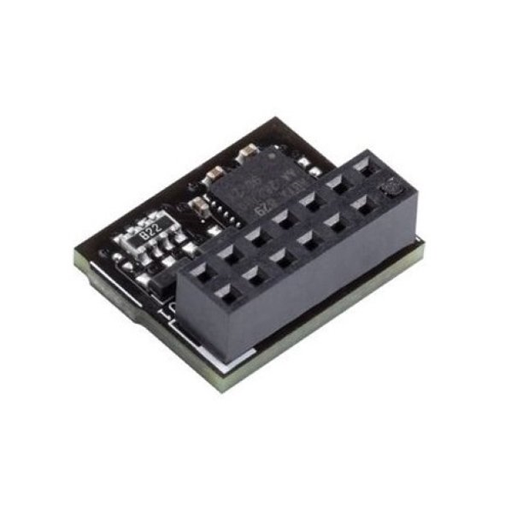
TPM

Slide 8
HSM
A Hardware Security Module (HSM) is a device used to manage or store encryption keys. It can also assist in cryptographic operations such as encryption, hashing, or the application of digital signatures.
HSMs typically are peripheral devices connected via USB or a network connection. HSMs have tamper-protection mechanisms to prevent physical access to the secrets they protect.
Because of their dedicated design, they can offer significant performance advantages over general-purpose computers when it comes to cryptographic operations.
When an enterprise has significant levels of cryptographic operations, HSMs can provide throughput efficiencies.

Slide 9
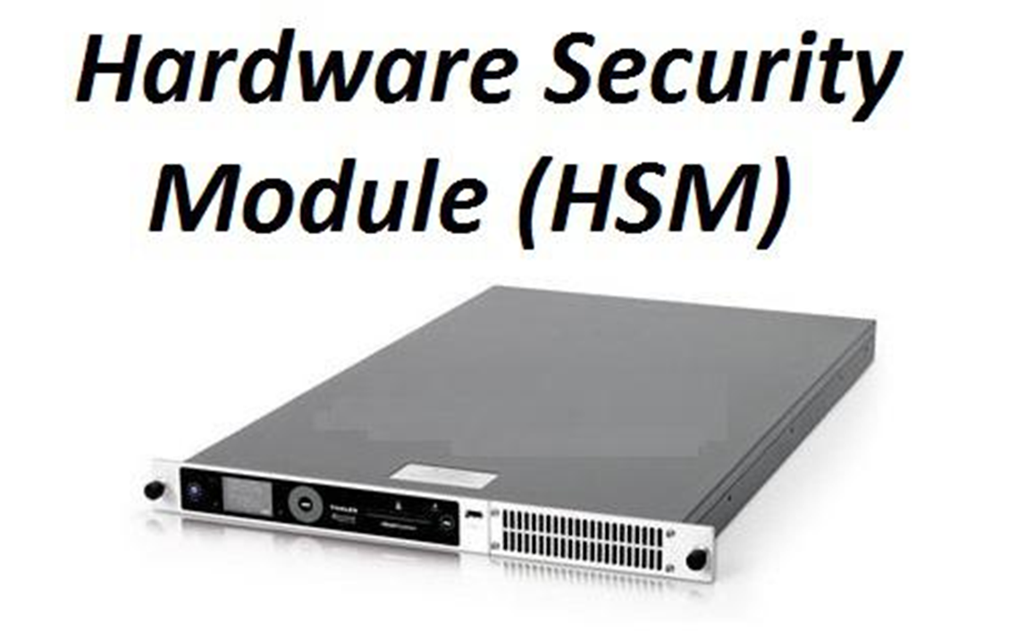
HSM

Slide 10
Knowledge-based Authentication
Knowledge-based authentication is a method where the identity of a user is verified via a common set of knowledge.
The standard methodology associated with authentication is an identity and a common secret that are previously recorded in a system, and then upon later use verified by recall on the user’s part and lookup by the system.
Knowledge-based authentication relies on a set of knowledge that, while it may be available to many, is from such a vast set of information that the recall only will work for the user themselves.
Security questions

Slide 11
Authentication
Authentication protocols are the standardized methods used to provide authentication services, and in the case of wireless networks, these are provided remotely.
Wireless networks have a need for secure authentication protocols. The following sections cover several key authentication protocols and methods in use today.

Slide 12
EAP
Extensible Authentication Protocol (EAP) is a protocol for wireless networks that expands on authentication methods used by the Point-to-Point Protocol (PPP).
PPP is a protocol that was commonly used to directly connect devices to each other.
EAP is designed to support multiple authentication mechanisms, including tokens, smart cards, certificates, one-time passwords, and public key encryption authentication.
There are two key elements concerning EAP.
First, it is only a framework to secure the authentication process.
Second, it can support multiple methods and itself is not an actual encryption method.

Slide 13
PEAP
PEAP, or Protected EAP, was developed to protect the EAP communication by encapsulating it with Transport Layer Security (TLS).
This is an open standard developed jointly by Cisco, Microsoft, and RSA.
EAP was designed assuming a secure communication channel.
PEAP provides that protection as part of the protocol via a TLS tunnel.
PEAP is widely supported by vendors for use over wireless networks.

Slide 14
EAP-FAST
The Wi-Fi Alliance added EAP-FAST to its list of supported protocols for WPA/WPA2 in 2010, and to WPA3 in 2018.
EAP-FAST (EAP Flexible Authentication via Secure Tunneling) is described in RFC 4851 and proposed by Cisco to be a replacement for LEAP, a previous Cisco version of EAP.
It offers a lightweight tunneling protocol to enable authentication.
The distinguishing characteristic is the passing of a Protected Access Credential (PAC) that is used to establish a TLS tunnel through which client credentials are verified.

Slide 15
EAP-TLS
The Wi-Fi Alliance also added EAP-TLS to its list of supported protocols for WPA/WPA2 in 2010, and WPA3 was added in 2018.
EAP-TLS is an IETF open standard (RFC 5216) that uses the TLS protocol to secure the authentication process.
EAP-TLS relies on TLS, an attempt to standardize the SSL structure to pass credentials.
This is still considered one of the most secure implementations, primarily because common implementations employ client-side certificates.
This means that an attacker must also possess the key for the client-side certificate to break the TLS channel.

Slide 16
EAP-TTLS
The Wi-Fi Alliance also added EAP-TTLS to its list of supported protocols for WPA/WPA2 in 2010, and WPA3 in 2018.
EAP-TTLS (the acronym stands for EAP–Tunneled TLS protocol) is a variant of the EAP-TLS protocol.
EAP-TTLS works much the same way as EAP-TLS, with the server authenticating to the client with a certificate, but the protocol tunnels the client side of the authentication, allowing the use of legacy authentication protocols:
PAP
CHAP
MS-CHAP
MS-CHAP-v2

Slide 17
Challenge-Handshake Authentication Protocol (CHAP)
Challenge-Handshake Authentication Protocol (CHAP) is used to provide authentication across a point-to-point link using PPP.
In this protocol, authentication after the link has been established is not mandatory.
CHAP is designed to provide authentication periodically through the use of a challenge/response system sometimes described as a three-way handshake

Slide 18
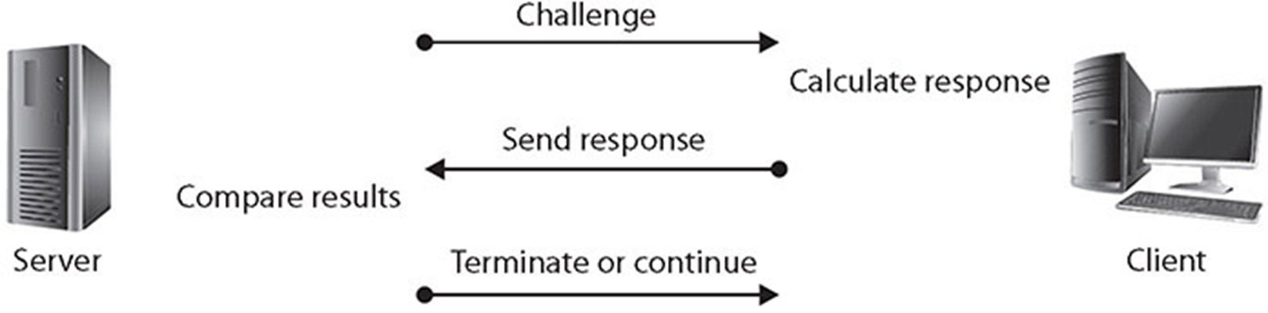
Challenge-Handshake Authentication Protocol (CHAP)

Slide 19
Challenge-Handshake Authentication Protocol (CHAP)
CHAP uses PPP, which supports three functions:
Encapsulate datagrams across serial links
Establish, configure, and test links using LCP (Link Control Protocol)
Establish and configure different network protocols using NCP (Network Control Protocol)
PPP supports two authentication protocols:
Password Authentication Protocol (PAP)
Challenge-Handshake Authentication Protocol (CHAP)

Slide 20
Password Authentication Protocol (PAP)
Password Authentication Protocol (PAP) authentication involves a two-way handshake in which the username and password are sent across the link in clear text.
PAP authentication does not provide any protection against playback and line sniffing.
PAP is a cleartext authentication protocol and hence is subject to interception.
CHAP uses a challenge/response handshake protocol to secure the channel.
PAP is now a deprecated standard.

Slide 21
802.1X
802.1X is an authentication standard that supports port-based authentication services between a user and an authorization device, such as an edge router.
802.1X is commonly used on wireless access points as a port-based authentication service prior to admission to the wireless network.
802.1X over wireless uses either 802.11i or an EAP-based protocol, such as EAP-TLS or PEAP-TLS.

Slide 22
RADIUS
Remote Authentication Dial-In User Service (RADIUS) is a protocol that was developed as an AAA protocol.
The IETF AAA Working Group has proposed extensions to RADIUS (RFC 2882) and a replacement protocol called Diameter (RFC 7075).
RADIUS is designed as a connectionless protocol utilizing User Datagram Protocol (UDP) as its transport-level protocol. Connection-type issues, such as timeouts, are handled by the RADIUS application instead of the transport layer.
RADIUS utilizes UDP ports 1812 for authentication and authorization and 1813 for accounting functions.

Slide 23
RADIUS
RADIUS is a client/server protocol. The RADIUS client is typically a network access server (NAS).
The RADIUS server is a process or daemon running on a Linux or Windows Server machine.
Communications between a RADIUS client (NAS) and RADIUS server are encrypted using a shared secret that is manually configured into each entity and not shared over a connection.
The communications between a user (typically a PC) and the RADIUS client are subject to compromise.
This is important to note because if the user’s machine (the PC) is not the RADIUS client (the NAS), then communications between the PC and the NAS are typically not encrypted and are passed in the clear.

Slide 24
Single Sign-On (SSO)
Single sign-on (SSO) is a form of authentication that involves the transferring of credentials between systems.
As more and more systems are combined in daily use, users are forced to have multiple sets of credentials.
A user may have to log in to three, four, five, or even more systems every day just to do her job.
Single sign-on allows a user to transfer her credentials so that logging in to one system acts to log her in to all of them.
This has the advantage of reducing login hassles for the user. It also has the disadvantage of combining the authentication systems in such a way that if one login is compromised, then all the user’s logins are compromised.

Slide 25
Security Assertion Markup Language (SAML)
Security Assertion Markup Language (SAML) is a single sign-on capability used for web applications to ensure user identities can be shared and are protected.
It defines standards for exchanging authentication and authorization data between security domains.
It is becoming increasingly important with cloud-based solutions and with Software as a Service (SaaS) applications, as it ensures interoperability across identity providers.

Slide 26
Security Assertion Markup Language (SAML)
SAML is an XML-based protocol that uses security tokens and assertions to pass information about a “principal” (typically an end user) to a SAML authority (an “identity provider” or IdP) and the service provider (SP).
The principal requests a service from the SP, which then requests and obtains an identity assertion from the IdP.
The SP can then grant access or perform the requested service for the principal.
By allowing identity providers to pass on credentials to service providers, SAML allows you log in too many different websites using one set of credentials.

Slide 27
Terminal Access Controller Access Control System Plus (TACACS+)
The Terminal Access Controller Access Control System Plus (TACACS+) protocol is the current generation of the TACACS family.
TACACS+ has extended attribute control and accounting processes.
One of the fundamental design aspects is the separation of authentication, authorization, and accounting in this protocol.
TACACS+ uses TCP as its transport protocol, typically operating over TCP port 49. This port is used for the login process.
Both UDP and TCP port 49 are reserved for the TACACS+ login host protocol.

Slide 28
OAuth
OAuth (Open Authorization) is an open protocol that allows secure, token-based authorization on the Internet from web, mobile, and desktop applications via a simple and standard method.
OAuth is used by companies such as Google, Facebook, Microsoft, and Twitter to permit users to share information about their accounts with third-party applications or websites.
OAuth’s main strength is that it can be used by an external partner site to allow access to protected data without having to re-authenticate the user.
OAuth was created to remove the need for users to share their passwords with third-party applications, instead substituting a token.

Slide 29
OpenID
OpenID is a simple identity layer on top of the OAuth 2.0 protocol.
OpenID allows clients of all types, including mobile, JavaScript, and web-based clients, to request and receive information about authenticated sessions and end users.
OpenID is intended to make the process of proving who you are easier.
To do authorization, a second process is needed, and OpenID is commonly paired with OAuth 2.0.
OpenID was created for federated authentication that lets a third party, such as Google or Facebook, authenticate your users for you, by using accounts that the users already have.

Slide 30
Kerberos
Developed as part of MIT’s project Athena, Kerberos is a network authentication protocol designed for a client/server environment.
Kerberos securely passes a symmetric key over an insecure network using the Needham-Schroeder symmetric key protocol.
Kerberos is built around the idea of a trusted third party, termed a key distribution center (KDC), which consists of two logically separate parts: an authentication server (AS) and a ticket-granting server (TGS).
Kerberos communicates via “tickets” that serve to prove the identity of users.

Slide 31
Kerberos
Named after Kerberos, the three-headed dog of Greek mythology, Kerberos is designed to work across the Internet, an inherently insecure environment.
Kerberos uses strong encryption so that a client can prove its identity to a server, and the server can in turn authenticate itself to the client.
A complete Kerberos environment is referred to as a Kerberos realm.
The Kerberos server contains user IDs and hashed passwords for all users that will have authorizations to realm services.
The Kerberos server also has shared secret keys with every server to which it will grant access tickets.

Slide 32
Kerberos
The basis for authentication in a Kerberos environment is the ticket.
Tickets are used in a two-step process with the client.
The first ticket is a ticket-granting ticket (TGT) issued by the AS to a requesting client.
The client can then present this ticket to the Kerberos server with a request for a ticket to access a specific server.
This client-to-server ticket is used to gain access to a server’s service in the realm.
Since the entire session can be encrypted, this will eliminate the inherently insecure transmission of items such as a password that can be intercepted on the network.
Tickets are time-stamped and have a lifetime, so attempting to reuse a ticket will not be successful.

Slide 33
Kerberos
The steps involved in Kerberos authentication are as follows:
The user presents credentials and requests a ticket from the Key Distribution Server (KDS).
The KDS verifies credentials and issues a TGT.
The user presents a TGT and request for service to the KDS.
The KDS verifies authorization and issues a client-to-server ticket.
The user presents a request and a client-to-server ticket to the desired service.
If the client-to-server ticket is valid, service is granted to the client.

Slide 34
Access Control Schemes
The term access control describes a variety of protection schemes.
Access is the ability of a subject (such as an individual or a process running on a computer system) to interact with an object (such as a file or hardware device).
Authentication, on the other hand, deals with verifying the identity of a subject.

Slide 35
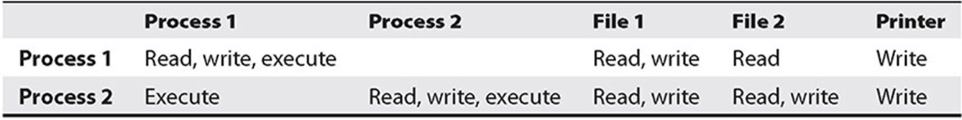
Access Control Matrix
Access controls can be implemented in several ways.
An access control matrix provides the simplest framework for illustrating the process.
In this matrix, the system is keeping track of two processes, two files, and one hardware device. Process 1 can read both File 1 and File 2 but can write only to File 1. Process 1 cannot access Process 2, but Process 2 can execute Process 1. Both processes have the ability to write to the printer.

Slide 36
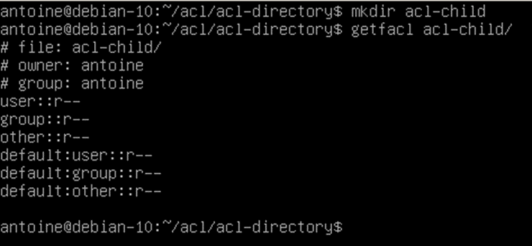
Access Control List (ACL)
An ACL is nothing more than a list that contains the subjects that have access rights to a particular object.
The list identifies not only the subject, but the specific access granted to the subject for the object.
Typical types of access include read, write, and execute, as indicated in the sample access control matrix.

Slide 37
Attribute-Based Access Control (ABAC)
Attribute-Based Access Control (ABAC) is a form of access control based on attributes.
These attributes can be in a wide variety of forms, such as user attributes, resource or object attributes, and environmental attributes.
For instance, a doctor can access medical records, but only for patients to which she is assigned, or only when she is on shift.
The ABAC process of authorization evaluates specific rules and policies against attributes associated with a subject or object.
ABAC is often used in large enterprises that use a federated structure.
It is somewhat more complicated and costly to implement than other access control models.

Slide 38
Role-Based Access Control
ACLs can be cumbersome and can take time to administer properly. Another access control mechanism that has been attracting increased attention is Role-Based Access Control (RBAC).
In this scheme, instead of each user being assigned specific access permissions for the objects associated with the computer system or network, each user is assigned a set of roles that he or she may perform.
The roles are in turn assigned the access permissions necessary to perform the tasks associated with those roles.
Users will thus be granted permissions to objects in terms of the specific duties they must perform—not according to a security classification associated with individual objects.

Slide 39
Rule-Based Access Control
Rule-Based Access Control (RBAC) also uses objects such as ACLs to help determine whether or not access should be granted.
In this case, a series of rules is contained in the ACL, and the determination of whether to grant access will be made based on these rules.
Rule-based access control can actually be used in addition to or as a method of implementing other access control methods.

Slide 40
Mandatory Access Control (MAC)
A less frequently employed system for restricting access is Mandatory Access Control (MAC).
This system, generally used only in environments in which different levels of security classifications exist, is much more restrictive regarding what a user is allowed to do.
Mandatory Access Control is “a means of restricting access to objects based on the sensitivity (as represented by a label) of the information contained in the objects and the formal authorization (i.e., clearance) of subjects to access information of such sensitivity.”
In this case, the owner or subject can’t determine whether access is to be granted to another subject; it is the job of the operating system to decide.

Slide 41
Mandatory Access Control (MAC)
In MAC, the security mechanism controls access to all objects, and individual subjects cannot change that access.
The key here is the label attached to every subject and object. The label will identify the level of classification for that object and the level to which the subject is entitled.
Think of SIPR
Designed for the military classification systems.
Top Secret
Secret
Confidential

Slide 42
Discretionary Access Control (DAC)
DACs are “a means of restricting access to objects based on the identity of subjects and/or groups to which they belong.
The controls are discretionary in the sense that a subject with a certain access permission is capable of passing that permission (perhaps indirectly) on to any other subject.”
The owner of an object can decide which other subjects can have access to the object and what specific access they can have.
Think of NIPR

Slide 43
Conditional Access
Conditional access is an access control scheme where specific conditions are examined before access is given.
A condition could be the user location when accessing resources.
Based on “If {condition} then {action}” statements.

Slide 44
Privileged Access Management (PAM)
Privileged accounts are any accounts with greater-than-normal user access.
Privileged accounts are typically root- or administrative-level accounts and represent risk in that they are unlimited in their powers.
These accounts require regular real-time monitoring, if at all possible, and should always be monitored when operating remotely.
Administrators may need to perform tasks via a remote session in certain scenarios, but when they do, they first need to identify the purpose and get approval.

Slide 45
Privileged Access Management (PAM)
Privileged access management is a combination of the policies, procedures, and technologies for controlling access to and use of elevated or privileged accounts.
This enables the organization to log and control privileged access across the entire environment.
The primary purpose is to limit the attack surface that these accounts have, and to minimize exposure based on current operational needs and conditions.

Slide 46
File System Permissions
Files need security on systems, to prevent unauthorized access and unauthorized alterations.
File system security is the set of mechanisms and processes employed to ensure this critical function.
You need a file system capable of supporting user-level access differentiation—something NTFS does but FAT32 does not.
Next, you need to have a functioning access control model—MAC, DAC, ABAC, or other, as previously described in this chapter.
Then you need a system to apply the users’ permissions to the files, which can be handled by the OS, although administering and maintaining this can be a challenge.

Slide 47
File System Permissions
If multiple users share a computer system, the system administrator likely needs to control who is allowed to do what when it comes to viewing, using, or changing system resources.
Permissions control what a user is allowed to do with objects on a system, and rights define the actions a user can perform on the system itself.
Permissions can be applied to a specific user or group to control that user or group’s ability to view, modify, access, use, or delete resources such as folders and files.

Slide 48
File System Permissions
The basic categories of NTFS permissions are as follows:
Full Control A user/group can change permissions on the folder/file, take ownership if someone else owns the folder/file, delete subfolders and files, and perform actions permitted by all other NTFS folder permissions.
Modify A user/group can view and modify files/folders and their properties, can delete and add files/folders, and can delete properties from or add properties to a file/folder.
Read & Execute A user/group can view the file/folder and can execute scripts and executables, but they cannot make any changes (files/folders are read-only).

Slide 49
File System Permissions
The basic categories of NTFS permissions are as follows (cont.):
List Folder Contents A user/group can list only what is inside the folder (applies to folders only).
Read A user/group can view the contents of the file/folder and the file/folder properties.
Write A user/group can write to the file or folder.

Slide 50
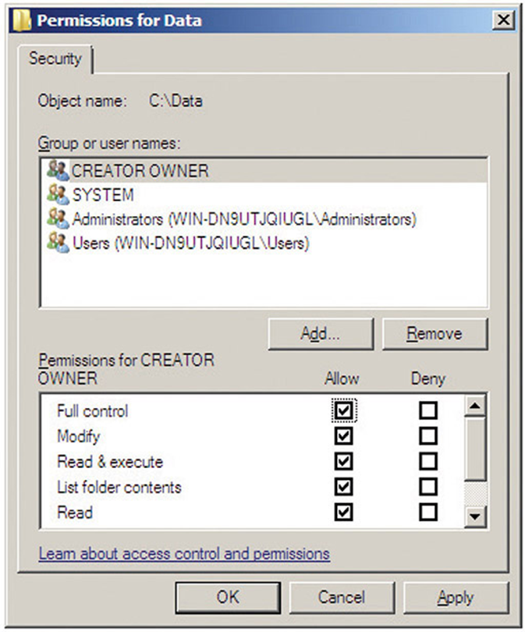
File System Permissions

Slide 51
File System Permissions
Under UNIX operating systems, file permissions consist of three distinct parts:
Owner permissions (read, write, and execute) The owner of the file
Group permissions (read, write, and execute) The group to which the owner of the file belongs
World permissions (read, write, and execute) Anyone else who is not the owner and does not belong to the group to which the owner of the file belongs
Sometime called a File Access Control List (FACL)

